Slide 1
Radio Frequency Behavior
As an RF signal travels through the air and other mediums, it can move and behave in different manners.
RF signal behavior has an impact upon the speed of a transmission and distance achieved between two devices
  Classified as propagation behaviors

Slide 2
Propagation Behaviors
Common misconception: an RF signal goes out from an antenna in a single signal that takes a direct path to a receiver. Signal may “bounce” off of walls and other objects
    Wave propagation: the way in which the signal travels
Several different behaviors the wave will take:
  Absorption, reflection, scattering, refraction, and diffraction

Slide 3
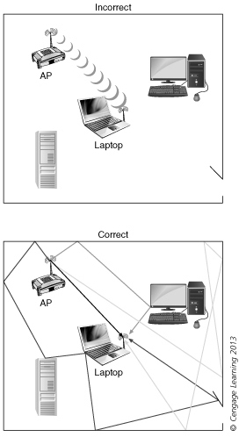
Incorrect and correct views of wave propagation and multipath

Slide 4
Propagation Behaviors
Understand RF propagation behaviors helps for:
  Making sure that access points are deployed in the proper location,
  Making sure the proper type of antenna is chosen
  Monitoring the performance of the wireless network.

Slide 5
Absorption
The most common RF behavior is absorption, most materials will absorb some amount of an RF signal to varying degrees. Materials that will “absorb” the RF signal:
  Concrete, wood, and asphalt
  A 2.4 GHz signal will be 1/16 the original power after propagating through a concrete wall. That same signal will only lose one-half the original power after passing through drywall material.
  Absorption is a leading cause of attenuation (loss)

Slide 6
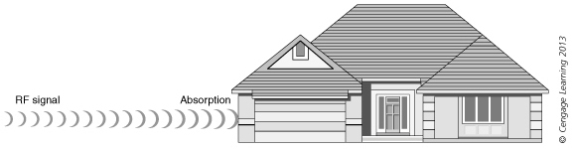
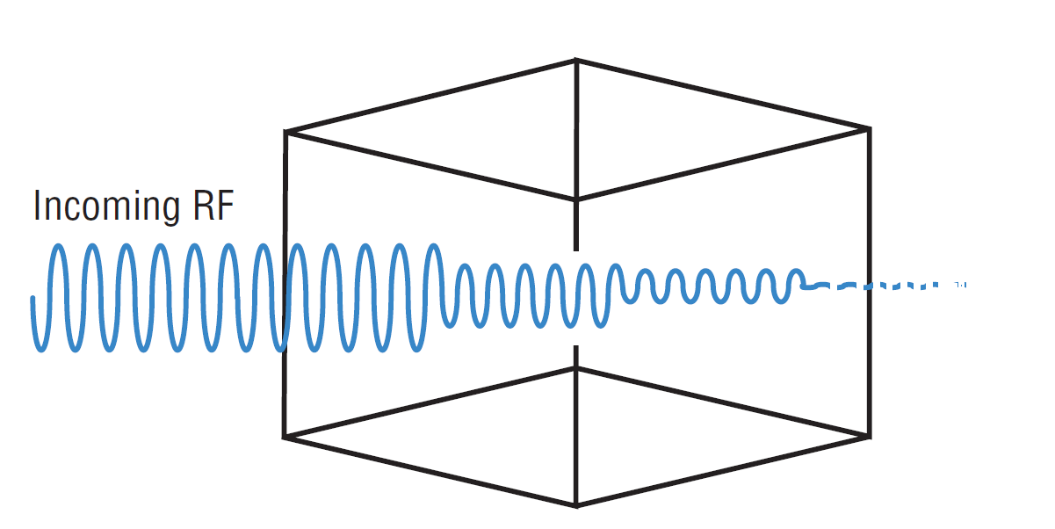
Absorption

Slide 7
Reflection
Reflection: when a signal is bounced off a smooth, nonabsorptive surface and change it direction
  Opposite of absorption
  Caused by objects that are very large and smooth (walls, buildings, and the surface of the earth)
  Objects made of metal will reflect a signal
  If not properly handled, reflections could cause a decrease in throughput and poor network performance in IEEE 802.11a/b/g wireless networks, because reflecting generate multiple reflected signals, this effect called multipath.

Slide 8
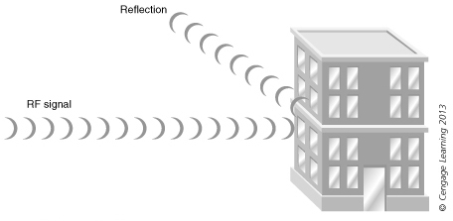
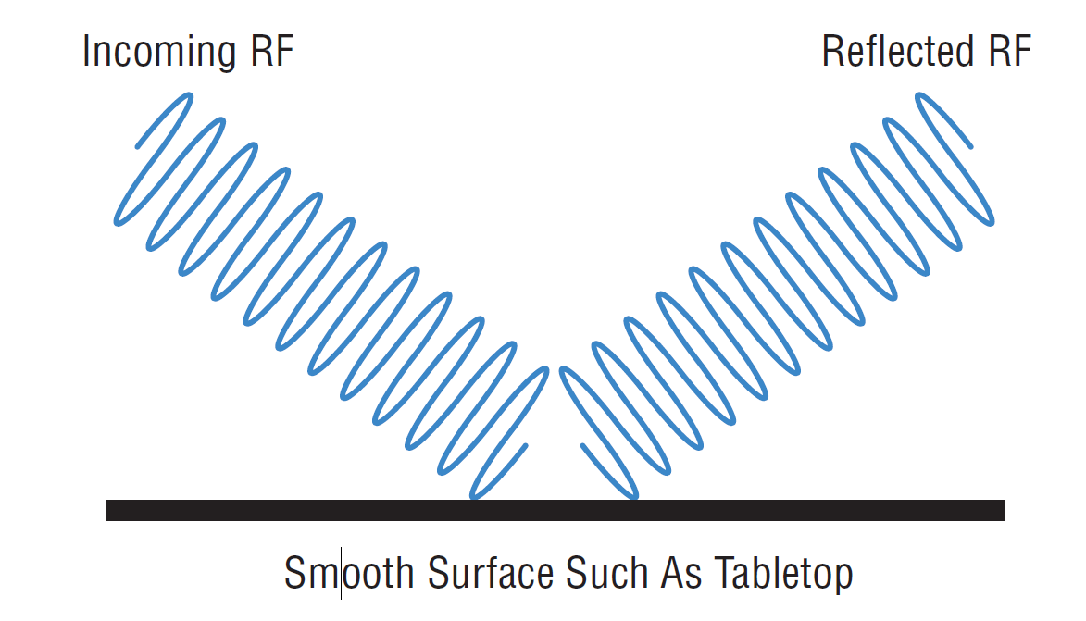
Reflection

Slide 9
Scattering
When an RF signal strikes an uneven surface, wavefronts of the signal will reflect off the uneven surface in several directions
Scattering can most easily be described as multiple reflections. These multiple reflections occur when the electromagnetic signal’s wavelength is larger than pieces of whatever medium the signal is reflecting from or passing through.
Caused by small objects such as: foliage, rocks, and sand
  Can also occur when RF signal comes in contact with airborne substances such as rain or heavy dust

Slide 10
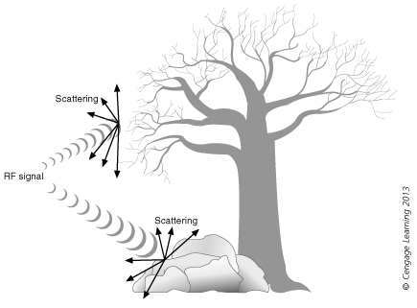
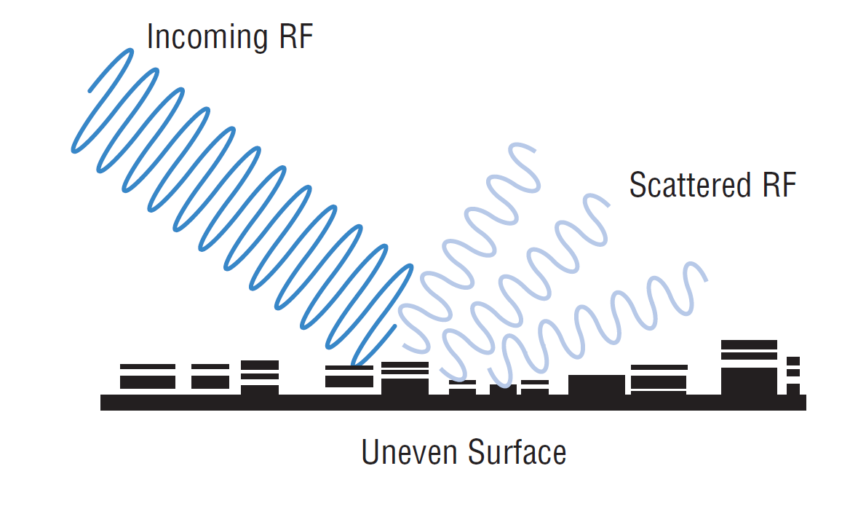
Scattering

Slide 11
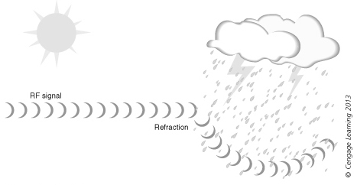
Refraction
When an RF signal moves from one medium to another of a different density the signal bends instead of traveling in a straight line
  Bending behavior is known as refraction
Refraction

Slide 12
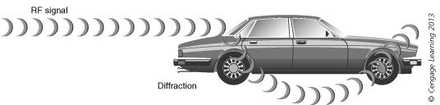
Diffraction
Diffraction occurs when an object with rough surfaces is in the path of the RF signal ad causes it to bend
Diffraction

Slide 13
Impact of Behaviors
Attenuation: loss of signal strength or decrease its amplitude
Two phenomena that can result in loss of an RF signal:
  Free Space Path Loss (FPSL): natural loss of signal strength through space
    Not a result of absorption, reflection, scattering, or diffraction
  Delay Spread: The difference in time of multipath signals that reach the receiver

Slide 14
Why Is Free Space Path Loss Important?
All radio devices have what is known as a receive sensitivity level. The radio receiver can properly interpret and receive a signal down to a certain fixed amplitude threshold. If a radio receives a signal above its amplitude threshold, the signal is powerful enough for the radio to sense and interpret the signal.
If the amplitude of a received signal is below the radio’s receive sensitivity threshold, the radio can no longer properly sense and interpret the signal

Slide 15
Amplification
Gain: Positive difference in amplitude between two signals
  The strengthening of a signal
  Achieved by amplification of signal
Amplification in delay spread can occur if copies arrive at the same time as the primary signal and are in phase
  End result is that the signal is strengthened
  Known as upfade

Slide 16
RF Signal Strength Measurements
Four units of measurements are used to represent RF signal strength:
  mW (milliwatts)
  dBm (decibel milliwatts)
  RSSI (Receive Signal Strength Indicator)
  Signal-to-Noise Ratio

Slide 17
Milliwatt (mW)
Voltage: electrical pressure on a wire and is measured in volts
Current: rate of electrical flow and is measured in amperes or amps
Resistance: Impedance of electrical flow and is measured in ohms
Electrical power: amount of energy and is measured in watts (W)
  A watt is a basic unit of power of 1 amp of current that flows at 1 volt
  Milliwatt (mW) is one thousandth of a watt of power

Slide 18
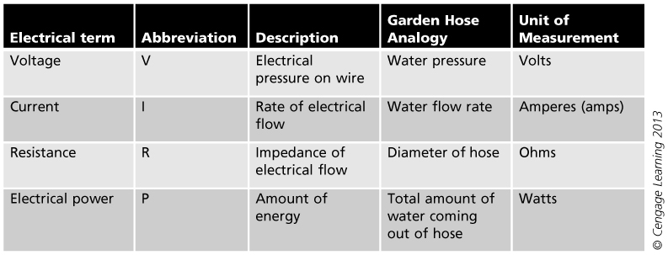
Electrical terminology

Slide 19
Decibel Milliwatt (dBm)
RF power measured by two units on two scales:
  Linear scale:
    Using milliwatts (mW)
    Reference point is zero
    Does not reveal gain or loss in relation to whole
  Relative scale:
    Reference point is the measurement itself
    Often use logarithms
    Measured in decibels (dB)
The reference point that relates the (dB) scale to the linear milliwatt scale is know as decibel milliwatt (dBm)

Slide 20
Receive Signal Strength Indicator (RSSI)
RSSI: a mechanism by which RF signal strength can be measured by the circuitry on a wireless NIC
  Value was intended for internal use by the wireless NIC
  Example – a wireless NIC can check the RSSI value to:
    Determine if it is clear to send its transmission
    Determine if the user is roaming beyond the range of a particular AP

Slide 21
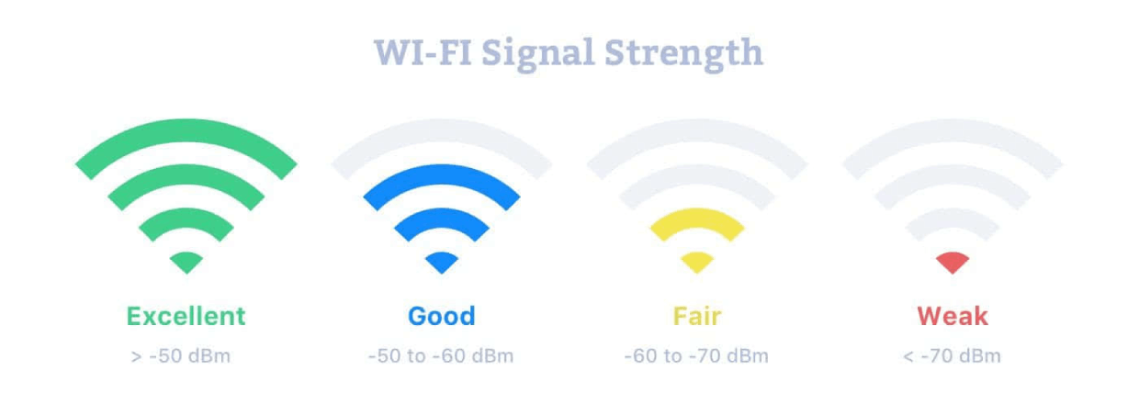
WiFi signal strength is typically measured in decibel milliwatts (dBm), a unit of the level that is used to indicate that a power ratio is expressed in decibels (dB) with reference to one milliwatt (mW).

Slide 22
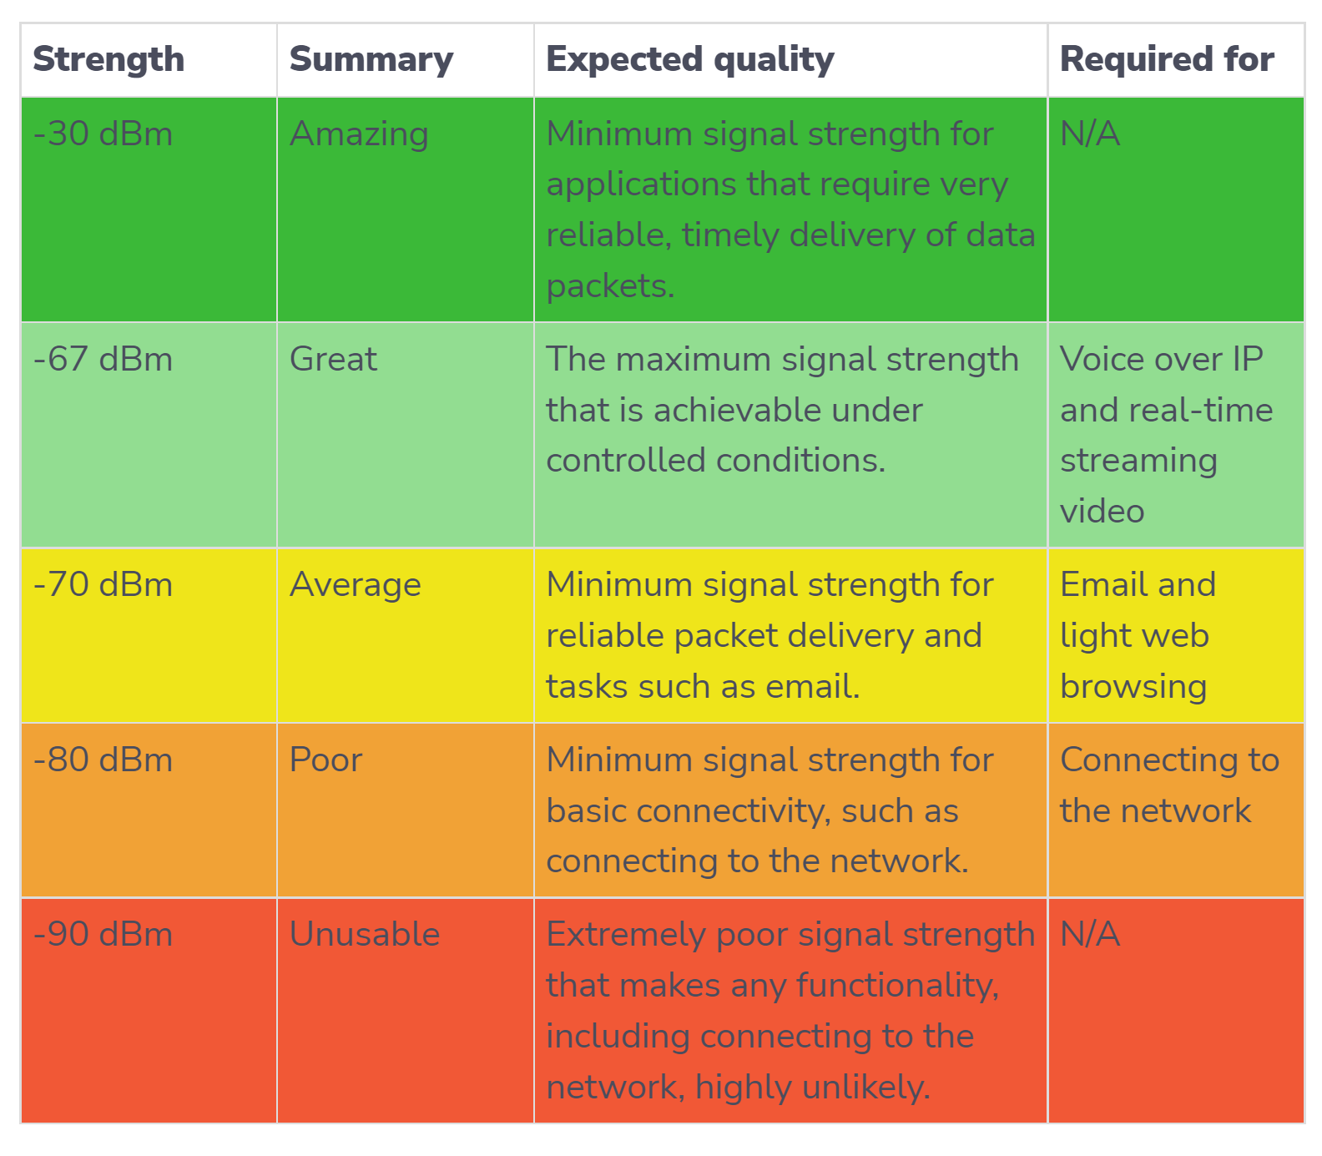

Slide 23
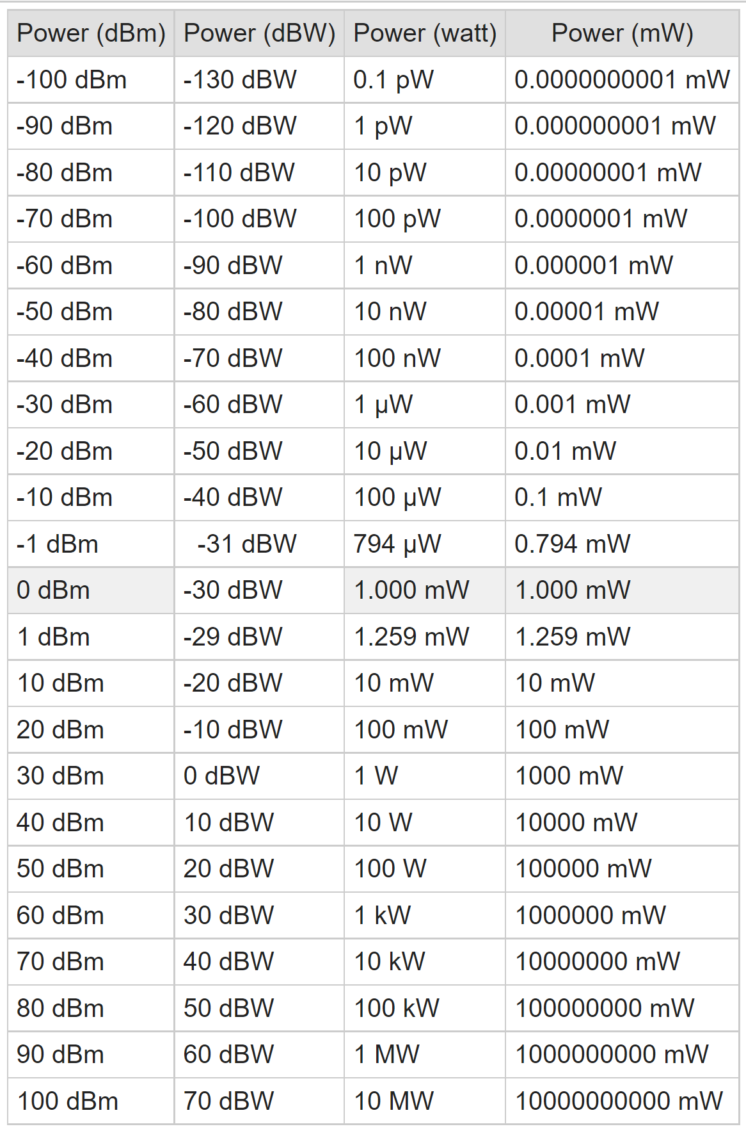

Slide 24
Signal-to-Noise Ratio
SNR is the difference in decibels between the received signal and the background noise level. For example, if you receive a signal of -70 dBm and the noise floor is measured at – 80 dBm, the SNR is 10 dB. Of course, you want the Signal-to-Noise ratio to be as high as possible so that it’s less likely for a signal to disappear in environmental noise.

Slide 25
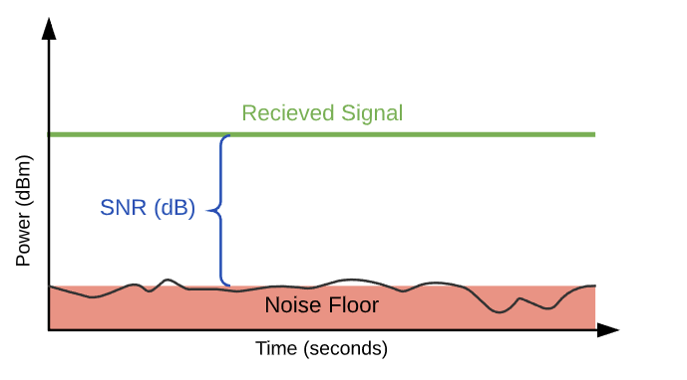

Slide 26
Signal-to-Noise Ratio
Noise: unwanted interference that impacts the RF signal
Signal-to-noise ratio (SNR): desired signal to undesired signal (noise) in the average power level of a transmission (given as dB)
How SNR values relate to WLAN performance:
  Over 40 dB = Excellent signal (5 bars)
  25 dB-40 dB = Very good signal (3-4 bars)
  15 dB-25 dB =Low signal (2 bars)
  10 dB-15 dB = Very low signal (1 bar)
  Less than 10 dB = No signal (0 bar)

Slide 27
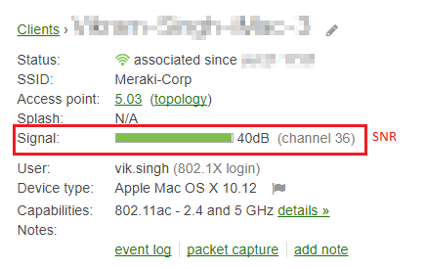
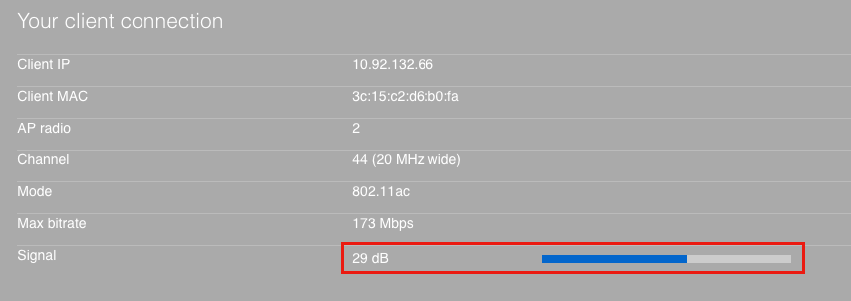

Slide 28
Summary
An analog signal is a continuous signal with no breaks in it
A digital signal consists of data that is discrete or separate, as opposed to continuous
Almost all wireless systems use digital modulations
Four units of measurements are used to represent RF signal strength: mW (milliwatts), dBm (decibel milliwatts), RSSI (Receive Signal Strength Indicator), and SNR

Slide 29
If you’re in the same room as your wireless router and have trouble achieving good network performance, the chances are that there is a lot of environmental noise from various electronic devices and other wireless networks.

Slide 30
Summary
The behavior of the RF signal has a significant impact on the speed of the transmission and the distance between two devices
  Propagation behaviors include: Absorption, reflection, scattering, refraction, and diffraction
  Loss of signal strength is known as attenuation
Free space path loss is the “natural” loss of signal strength through space
The difference in time of multipath signals that reach the receiver is known as delay spread

Slide 31
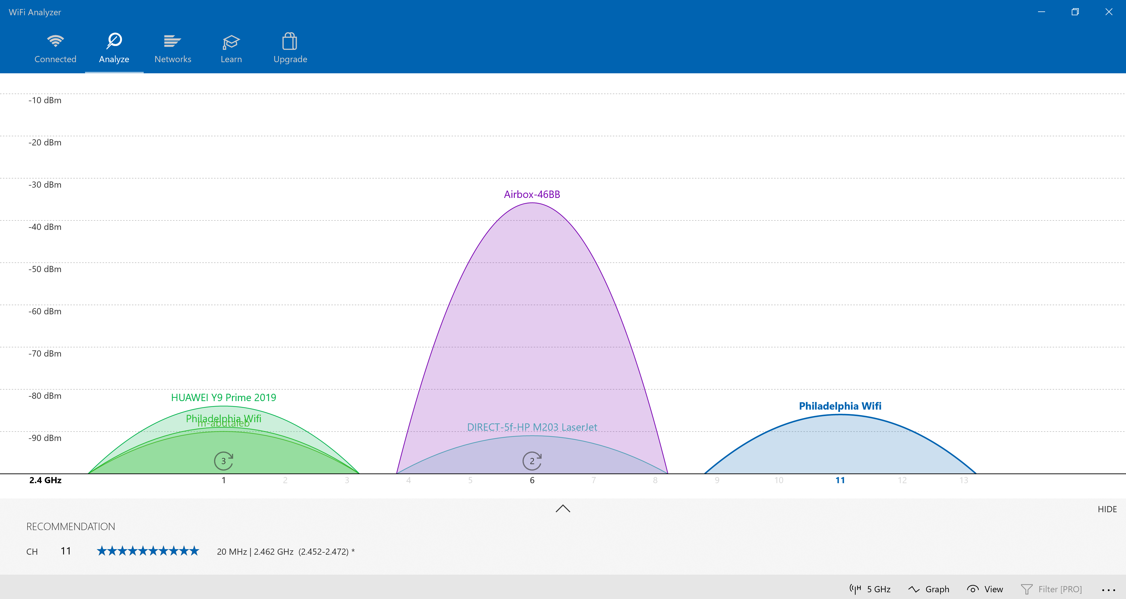

Slide 32
